Slide 1
The program will take input of 3 integer values.
Output the smallest value.
Example: if input is
Then output should be:
4
13
2
2

Slide 2
Given four values, which represents the quantity of quarters, dimes, nickels, and pennies.
Output the total value in $.
Example: if input is
Then output should be:
4
3
2
1
$1.41

Slide 3
Give total change in cents to the program, then program should output how to give the exact changes in: Quarters, Dimes, Nickles, and Pennies.
Example if input if input
Then output should be: output (notice the singular and plural)
0
43
No Change
1 Quarter
1 Dime
1 Nickle
3 Pennies

Slide 4
The program will calculate driving cost. It will take a car’s Km per liter gas and money per liter (both in float values), and output the gas cost for 20Km, 75Km, and 500Km.
Example: if input is
Then output should be:
15.6
2.05
3.29 9.86 65.71

Slide 5
Output range with increment of 5.
the program read 2 integers from user, the first must be less than the second.
Then the program output series number start from first and increment of 5.
The output end before number goes beyond the second.
Example
output
13
40
13 18 23 28 33 38

Slide 6
Counting digits:
Given any number n (integer number)
Count how many digits it have
Hint: divide the number by 10, remainder is the digit at ones place.
divide the number by 100, remainder is tens and ones place.

Slide 7
Print all numbers from 0 to 10, but skip 3, 6, and 9
Hints: use the ‘continue’ statement inside loop
FizzBuzz:
The program print all numbers from 1 to 100.
For those numbers divisible by 3, print ‘Fizz’ instead. For those numbers divisible by 5, print ‘Buzz’ instead. For those numbers divisible by both 3 and 5, print ‘FizzBuzz’ instead.

Slide 8
Make a program, which can do temperature conversion from Celsius to Fahrenheit, and vice versa.
Formula: c/5 = (f-32)/9
Make a program, which can do length conversion from inches to centimeters, and vice versa.
Formula: L_cm = L_in * 2.54

Slide 9
Make a program, check a triangle is equilateral, isosceles or scalene. Example:
the first side length: 6
the second side length: 8
the third side length: 12
It is a scalene triangle.
Think: how to check if 3 sides length entered can make a triangle, or they actually cannot make a triangle?
Hint: any 2 sides of triangle together, is longer than the 3rd side.

Slide 10
Fibonacci series:
make a program to generate Fibonacci series. (the next number is the sum of previous two numbers)
Start from 0, 1, after output 20 numbers then end.
3 digits Narcissistic number:
3 digits integer, which equals the sum of each digit cubed

Slide 11
Find prime number:
Find all prime numbers which <100.
Prime number: only 1 and itself as factor, no other factor.
Method 1: for each number, check if it has more factors other than 1 and itself
Method 2: sieve of Eratosthenes
list all numbers from 2 to 100, start delete those number which are multiples of 2, multiples of 3, etc. each time select one new prime number you find and delete its multiples, when you reach to 100, you have removed all non-prime numbers, and left all prime numbers.

Slide 12
3*n+1 sequence:
Start with any number, call it n
Rule for next item:
if n is even, divide it by 2.
If n not even, multiply it by 3 and then plus 1
Continue until the item becomes 1
Given a number n, for example 31, print all the series numbers

Slide 13
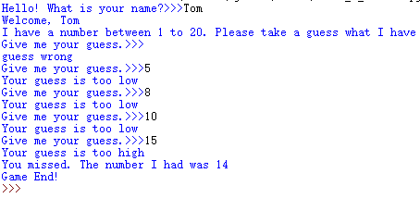
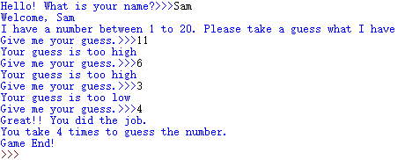
Guess the number
the program will randomly generate a number between 1 to 20, and ask the user to guess it.
If the user get it, the program stops and congrats the user. If not, prompt if user guess is high, or low.
After repeat guess it for 5 times if still not get it, the program stops. It reminds the user have missed this time and show to the user the number it holds.
Module in python is a collection of functions / programms for other person to use. You can create your own modules, one file is one module.
Name space decide how the program looks for different names. Module name random.randint()

Slide 14
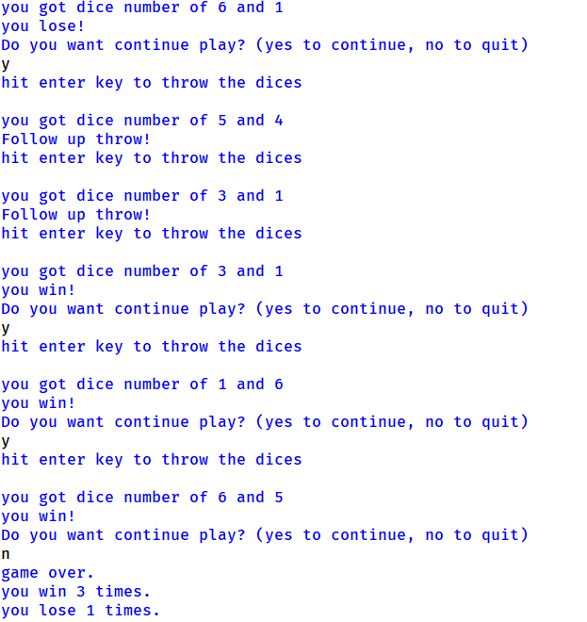
Dice game
The player throws a pair of dice. The sum of the two top faces is what matters so a 1 and a 3 is the same as 2 and 2.
The sum of two 6-sided dice can be any number from 2 to 12.
If the player throws a 7 or 11 on the first throw, the player wins. If the player throws a 2, 3, or 12, the player loses.
For any other result (4, 5, 6, 8, 9, 10), this result is recorded as what is called the player’s point and a follow-up throw is required.
On follow-up throws, a throw of 7 loses and a throw of the player’s point wins. For anything else, the game continues with the follow-up throw rules.

Slide 15
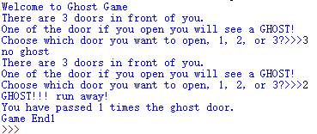
Ghost game
Randomly put a ghost behind one of 3 doors. Ask the user to choose one of the 3 doors to pass. If the ghost is behind the chosen door, game stops
After game stop shows to user how many times has passed the door with no ghost.

